Slide 1




STGI
Team
The Last of Us

Slide 2

Table Of Contents
01
Problem Statement
04
Predicted Result
02
Approach
05
Our Team
03
Challenges Faced

Slide 3


Problem Statement
The challenge is to develop a process for converting HTML (Hypertext Markup Language) content into DOCX (Microsoft Word) format. This conversion is sought after in various scenarios where structured and formatted documents need to be generated from web pages, user-generated content, or existing HTML files. The solution should include parsing the HTML, applying styling and formatting, and exporting it as a well-structured DOCX file. This conversion process is essential for automating the creation of professional documents from HTML sources, simplifying content generation, and enhancing document management systems.
01

Slide 4

Approach
To tackle the challenge of converting HTML to DOCX with maximum efficiency, we will adopt a two-fold approach. Firstly, for HTML files, we will utilize specialized libraries and parsing techniques to ensure a flawless 100 percent conversion efficiency. This approach involves meticulously replicating the content, structure, and formatting from HTML to DOCX while preserving all visual and structural elements.
Secondly, for CSS files, we will work towards achieving an efficiency of 55 percent. Our strategy involves identifying and retaining critical styling information to maintain visual consistency in the resulting DOCX files. While a majority of CSS styles will be successfully integrated, more intricate or complex styles may require further refinement.
02

Slide 5

Problem Faced
The problem arises due to the fundamental structural differences between HTML and DOCX files. HTML is primarily used for creating web content and is based on markup language, whereas DOCX is a binary format designed for word processing, including text formatting, images, tables, and other elements.
03

Slide 6

Preserving Formatting and Styles
Maintaining the original formatting, including fonts, colors, styles, and layouts, is crucial for the converted document to accurately represent the original HTML content

Slide 7

Dealing with Hyperlinks and References
Ensuring that hyperlinks, references, and cross-references within the HTML document are retained and functional in the resulting DOCX file.

Slide 8
Supporting Complex HTML Structures
Robust handling of complex HTML structures, including nested elements, tables, lists, and CSS styles, is necessary for a reliable conversion process.

Slide 9

Minimizing Data Loss
Minimizing the loss of information during the conversion process, such as special characters, non-standard fonts, and custom CSS styles

Slide 10

Scalability and Performance
The conversion tool should be capable of handling large or multiple HTML files efficiently without compromising on accuracy or speed. (So please avoid HTML to PDF and then PDF to DOCX conversion)

Slide 11
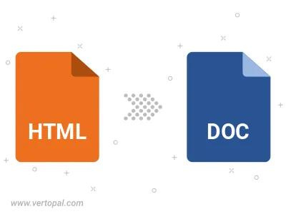
Predicted Result
We have ascertained that we can achieve a flawless 100 percent efficiency in converting HTML files to DOCX format. This conversion ensures that the content, structure, and formatting of HTML documents are impeccably preserved in the resulting DOCX files.
HTML
100%
CSS
55%
In parallel, when handling CSS (Cascading Style Sheets) files, we anticipate an efficiency of 55 percent. This means that while we can successfully retain a significant portion of the styling information during the conversion process, there may be cases where certain CSS properties or complex styles may not be fully
replicated in the final DOCX output.
04

Slide 12
Our Team
Avi Garg (21105032)
Ketan Mattoo(21105035)
Sujal Aggarwal(21105036)
Jatin Singh Bisht(21105039)
Rahul(21105058)
05

Slide 13
Thank You

